Slide 1

“ “Capstone Project Planning”
Presented By:
Mr.Thombare Rushikesh Dadaso.
Mr.Momin Faiz Sharif.
Mr.Markad Avinash Ganpat.
Ms.Jadhav Ankita Shahaji.
Final Year Comp.Engg
Under The Guidence Of:
Ms.Yadav K.V.
VPP Polytechnic College, Indapur .

Slide 2
Chapter 1
Introduction of project :-
As the title suggests, the application will be a web-based application for visually impaired persons using IVR- Interactive voice response, thus enabling everyone to control their mail accounts using their voice only and to be able to read, send, and perform all the other useful tasks. The system will prompt the user with voice commands to perform certain action and the user will respond to the same. The main benefit of this system is that the use of keyboard is completely eliminated, the user will have to respond through voice and mouse click only. Now you must be thinking that how will a blind person will see the correct position on the screen for doing mouse clicks. But this system will perform actions based on the clicks only that is left click or right click, it does not depend on the portion of the screen where the cursor is placed before the click giving user the freedom to click blindly anywhere on the screen.

Slide 3
Problem Definition :-
The project title voice based email system is a web based application developed that allows blind people to use email system easily. The proposed system focuses on providing the basic functionalities like composing, reading, sending and receiving emails along with voice based interaction.

Slide 4
Scope Of Project :-
There is wide future scope of this system many enhancements can be done in the system such as including different languages, including functionality of accessing the deleted mails and spam mails. Also, this system can be enhanced such that it can also send attachments which are more beneficial for visually challenged people. This system can be made available to all regional people who are not educated enough and inclusion of different languages will make this system easily accessible. Further more sign language system can also be integrated with the system to make the system more scalable and robust.

Slide 5
CHAPATER 2
2.1 Literature Survey /Comparison with Similar System :-
Existing systems of today are basically applications that provide accessing and managing of emails benefits to its users via web facilities. Making email widely used communication form. The existing systems do not support any voice commands or audio facilities and therefore it is not suitable for visually challenged people. Also, there are various existing search engine which take request in form of text from user and retrieve the relevant documents from server and responds by displaying it in the form of text which is not possible for visually challenged people .

Slide 6
CAHAPTER 3
Objective of project
This project aims at developing an email system that will help even a naïve, visually impaired person to use the services for communication without previous training. The system does not require the use of keyboard. Instead it will work only on mouse operations and speech conversion to text. This system can also be used by any normal person, for instance, by someone who is unable to read.

Slide 7
User Requirement-
Correctness is the degree to which the software performs is required functions.
The main moto of the degree performance is that the developed system should perform all the tasks the user has specified.
The developed software is user friendly by which the user can understand the software easily.
The user wants the software must be maintained properly before accepting the software.
Hardware and Software Requirements
Hardware:
Processor : Dual Core or above
RAM : 2GB or Higher
Hard Disk : 20GB

Slide 8
Software:
Operating system : Windows any version
Database server : MySQL
Tool : VSCode Editor
Libraries: Text-to-speech API , Speech-to-text API

Slide 9
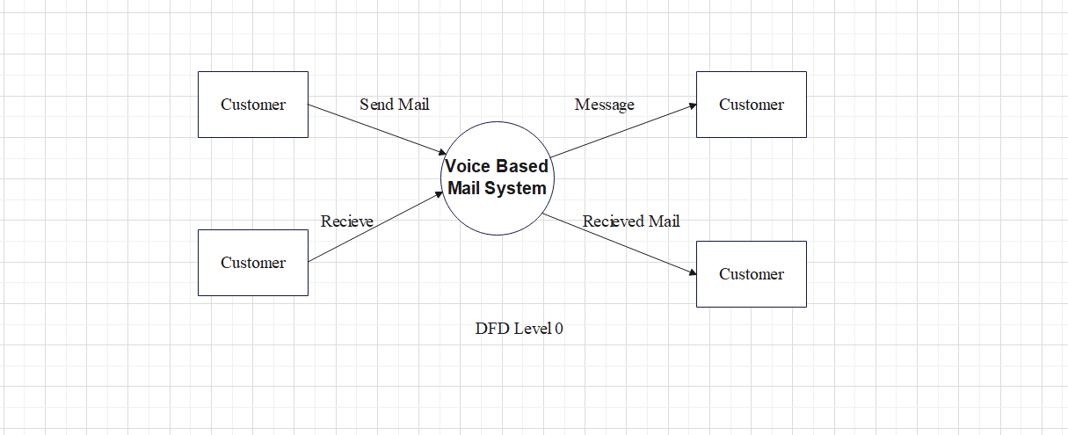
Software: Windows 10 pro PyCharm Editor Text-to-speech API Speech-to-text API Software: Windows 10 pro PyCharm Editor Text-to-speech API Speech-to-text API CHAPTER 4
4.0 System Design & Modelling:-
Data Flow Diagrams

Slide 10
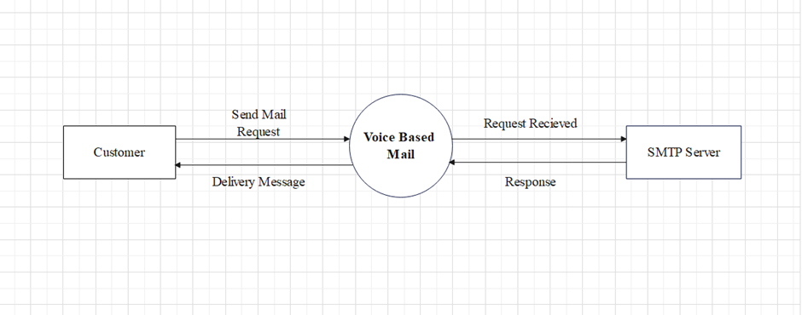

Slide 11
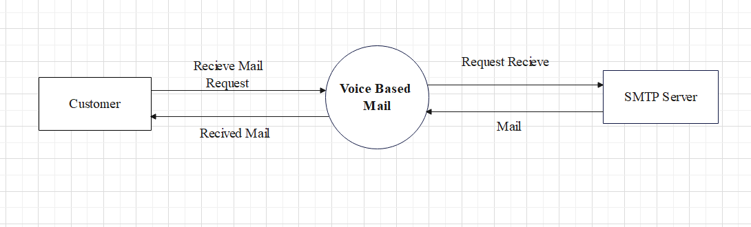

Slide 12
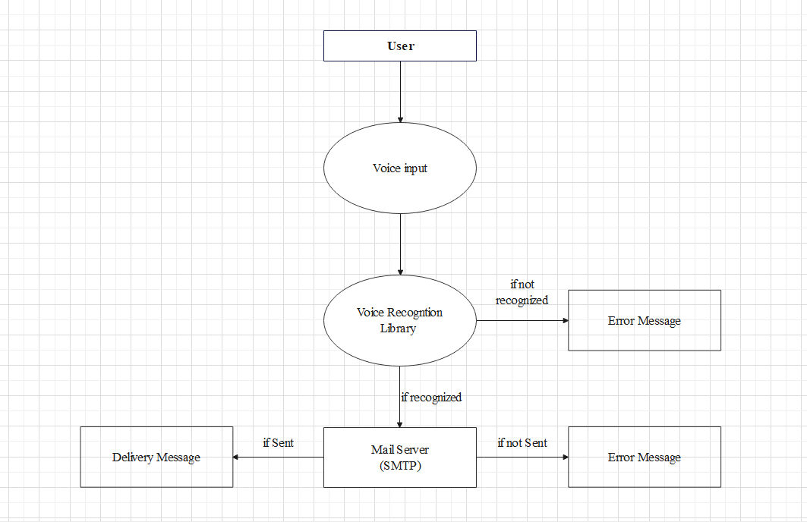

Slide 13
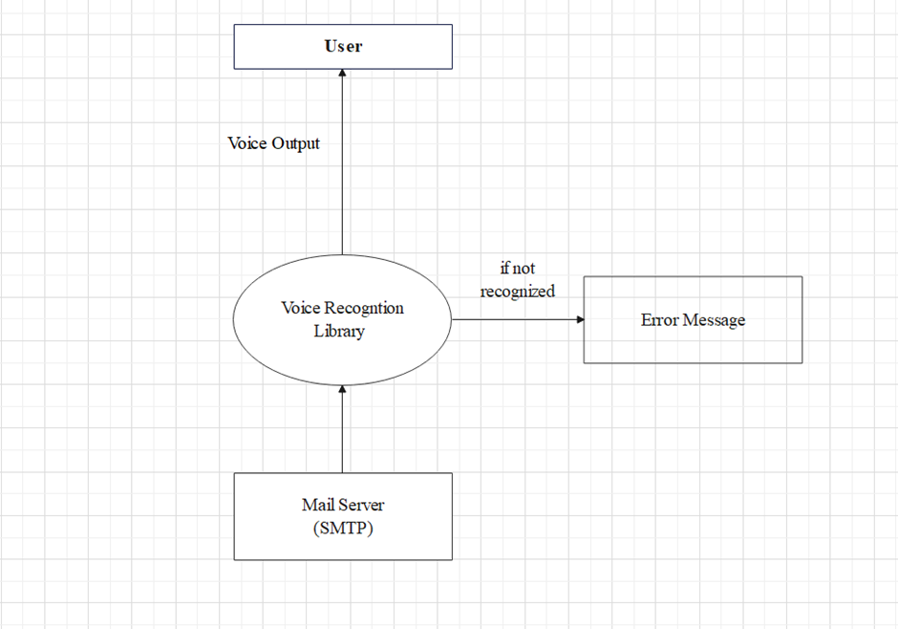

Slide 14
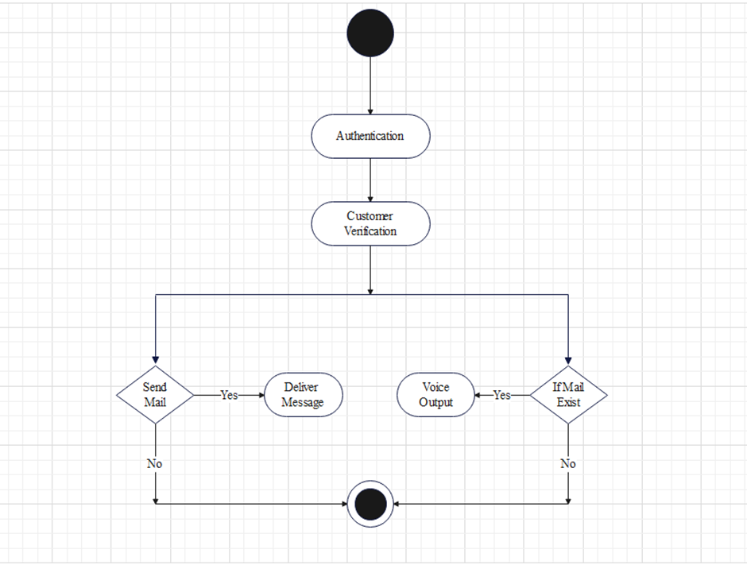

Slide 15
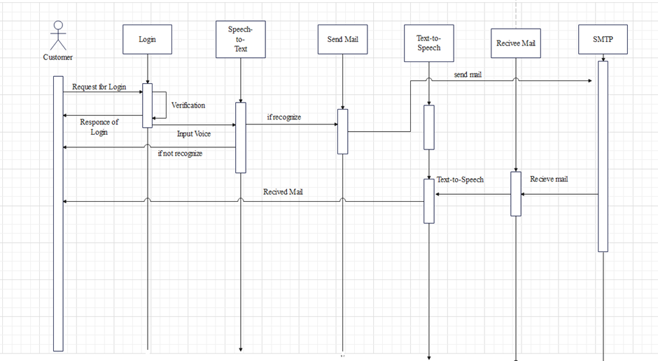

Slide 16
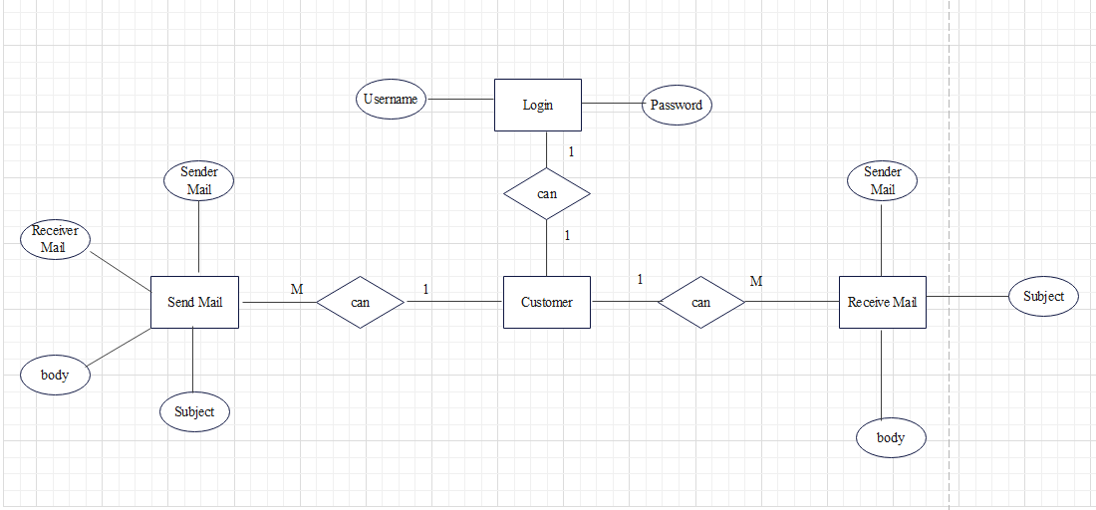

Slide 17
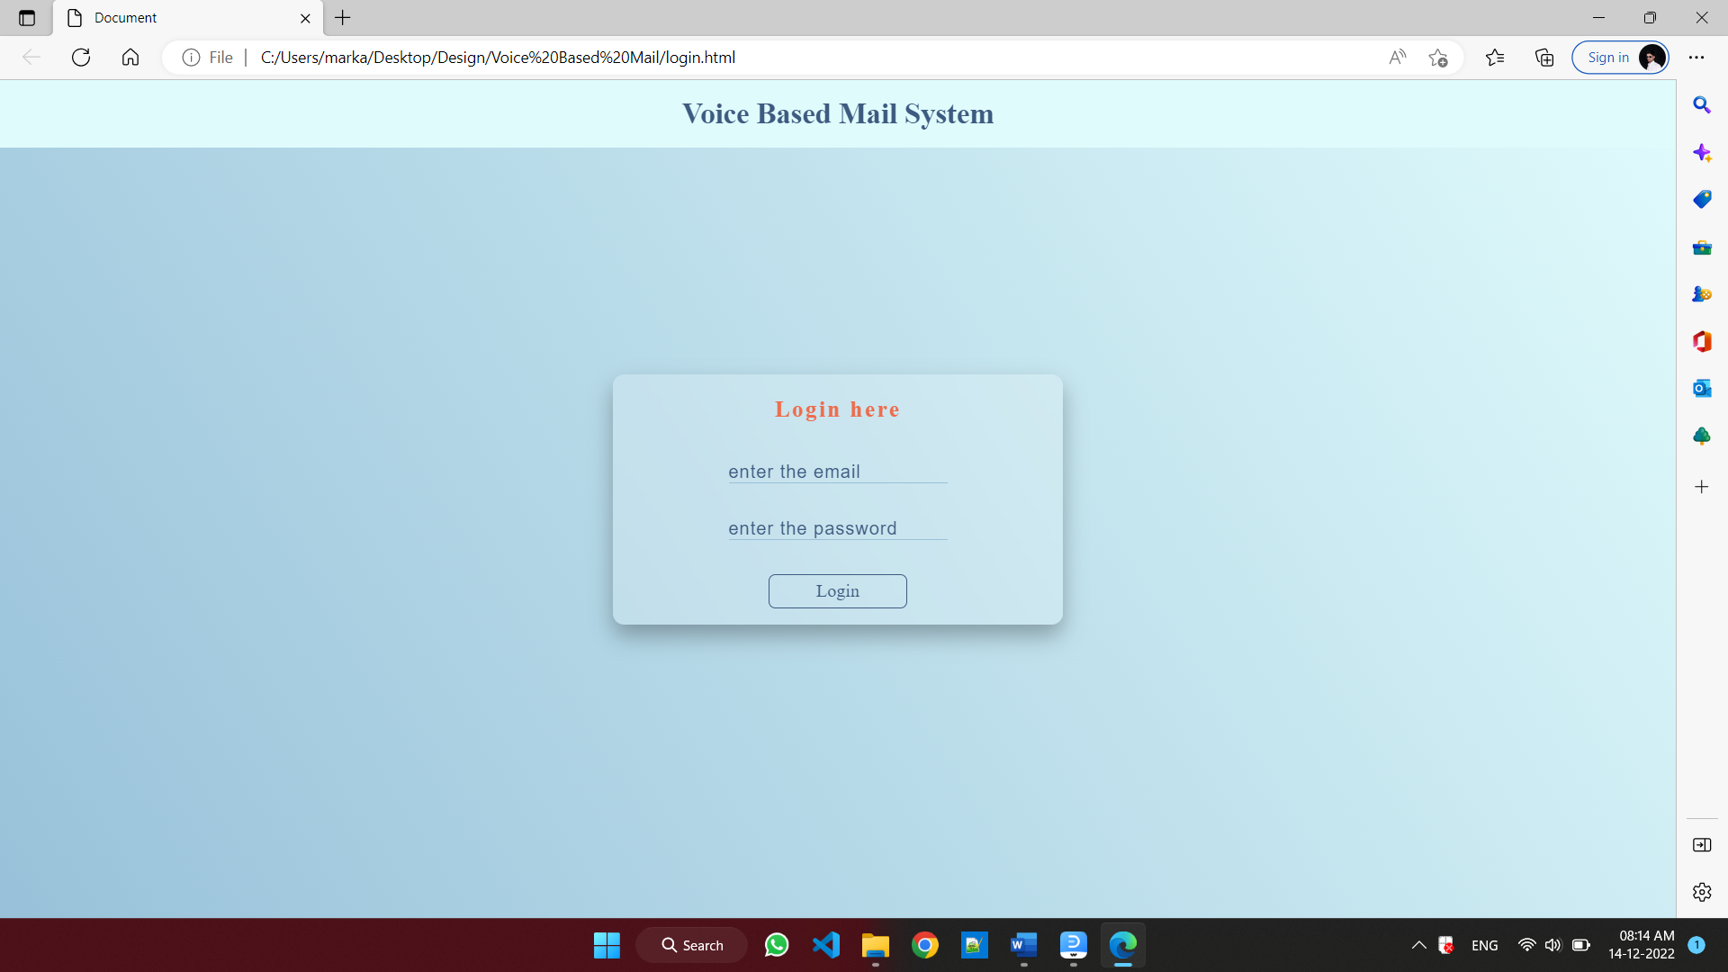
Design User Interface

Slide 18
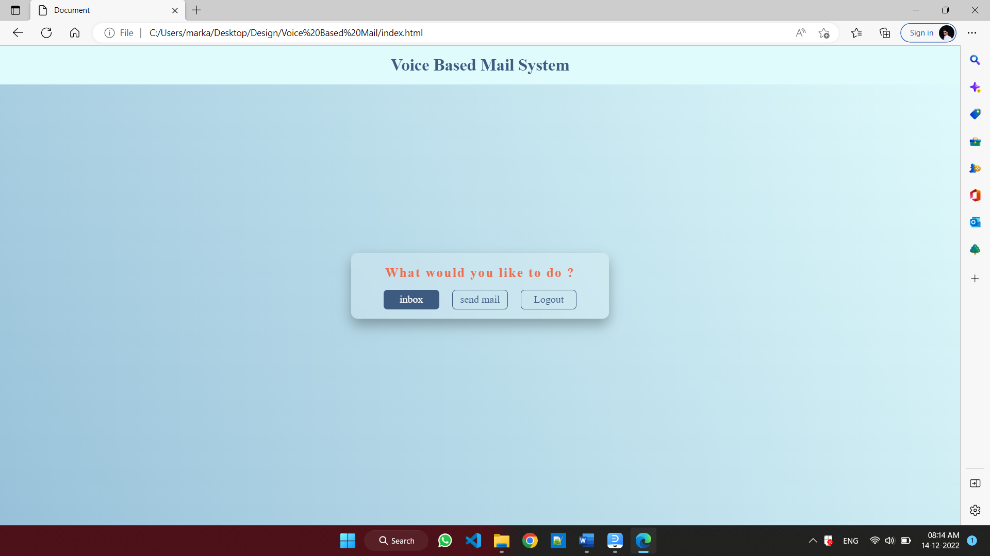

Slide 19
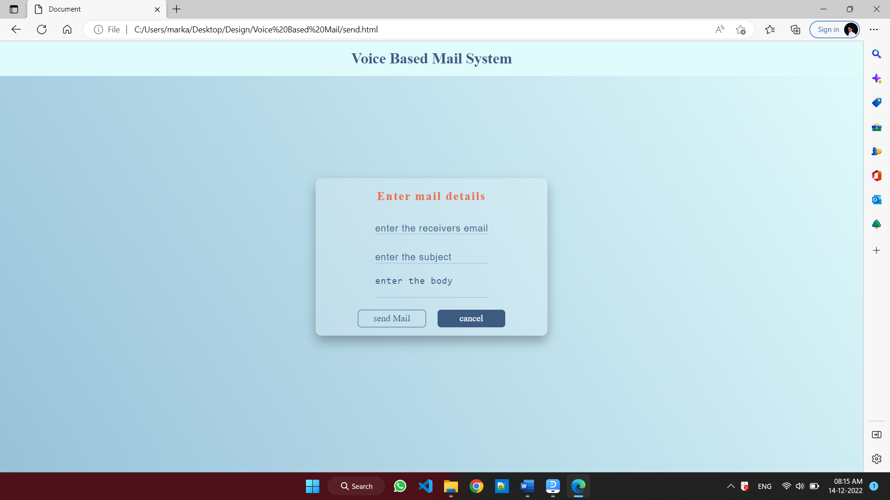

Slide 20
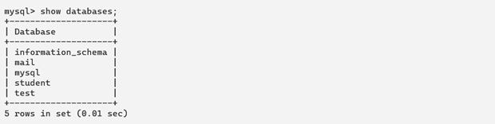
3.Database Design

Slide 21
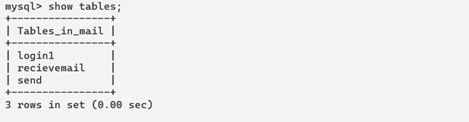

Slide 22
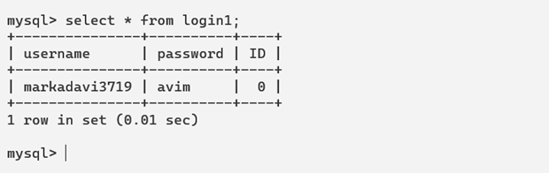

Slide 23
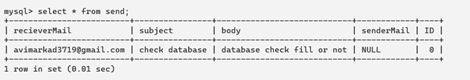

Slide 24
CHAPTER 5
Future Scope :
For the further development of the application , the attachments like images, word documents, audio and video files can be incorporated. Encryption and decryption algorithm can used to protect the username and password that is passed during login. More commands can be used to for different operations like search, mark important, delete, archive, go back, report spam, forward. Automated replying to received mails can be also integrated. The application can be adapted to different languages such that a variety of users can use the application.
Limitation :
Some people cannot use the voice-messaging systems.
Difficult for people to recall which options they used previously.
You will get tired of listening to the messages and end up deleting the messages without
listening to them, This causes you to miss the important messages.

Slide 25
CHAPTER 6
Books Referred :
Sonali Malap,Vaishali Shirke,Mrunali Chalke,Rohan Jain,Sonali Pakhmode.(2016). Voice based Email System for Visually Impaired People presented at IJSRD. .[Online].Available: https://www.scribd.com/doc/299063840/Voice-Based-Email-System-for-Visually-Impaired-People
Poonam Pate, Zeeshan Tamboli, Harsh Panchal, Diksha Jain.(2017). Voice Based E-mail Application for Blind/Visually Impaired People presented at IJARIIE.[Online].Available: http://ijariie.com/AdminUploadPdf
Web References :
https://www.geeksforgeeks.org/project-idea-voice-based-email-visually-challenged/
https://www.researchgate.net/publication/344296191_Voice_based_E-mail_for_the_Visually_Impaired
https://www.researchgate.net/publication/344296191_Voice_based_E-mail_for_the_Visually_Impaired

Slide 26
Conclusion :
This project proposes an web, designed specifically for visually challenged people. This web provides a voice based mailing service where they could read and send mail on their own, without any guidance. Here the users have to use certain keywords which will perform certain actions for e.g. Received mails, Send mails, Compose Mail. VMAIL can be used by a blind person to access mails easily and efficiently. Thus reliance of visually impaired on other people for their activities related to mail can be reduced.

Slide 27
End

